Slide 1
MGMT298D
Science and Strategy of AI
Week 8
Building LLM Apps
UCLA Anderson School of Management
Auyon Siddiq

Slide 2
Today's Class
Part 1: Building with LLMs
Prompting, RAG, and fine-tuning — three ways products adapt a model
Part 2: Product Sprint + live demo
Use the App Development Kit to build, test, and deploy

Slide 3
Part 1: Deployment Approaches

Slide 4
Prompting
Prompting changes the input, not the model weights
System prompt = lightweight customization for one app
Use it for role, rules, tone, and output format
No training step — the model is still the same model

Slide 5
System Prompting
System prompt: persistent instructions the app sends with every request
Good for role, rules, boundaries, tone, and output format
Can make the model act like a strict classifier or product coach
Lightweight customization, not new knowledge or new weights

Slide 6
Hidden Context
Hidden context: information the app sends that the user did not type
Examples: user profile, current page state, selected record, rubric, policy excerpt
Useful when the app needs continuity, personalization, or private product state
The model sees it as part of the request; it is hidden from the UI, not hidden from the model
Best practice: label it clearly and separate it from the user's words

Slide 7
Few-Shot Prompting
Few-shot prompting: include a few labeled examples in the prompt
Useful when the task is hard to explain but easy to demonstrate
Works well for classification, extraction, rewriting, and formatting
The model imitates the pattern at inference time
How many examples?
Good starting point: 2–5 short examples
Use 10 only if examples are tiny and the task really needs them
Large labeled datasets do not belong in the system prompt
If examples are large or changing: use RAG, ML, or fine-tuning

Slide 8
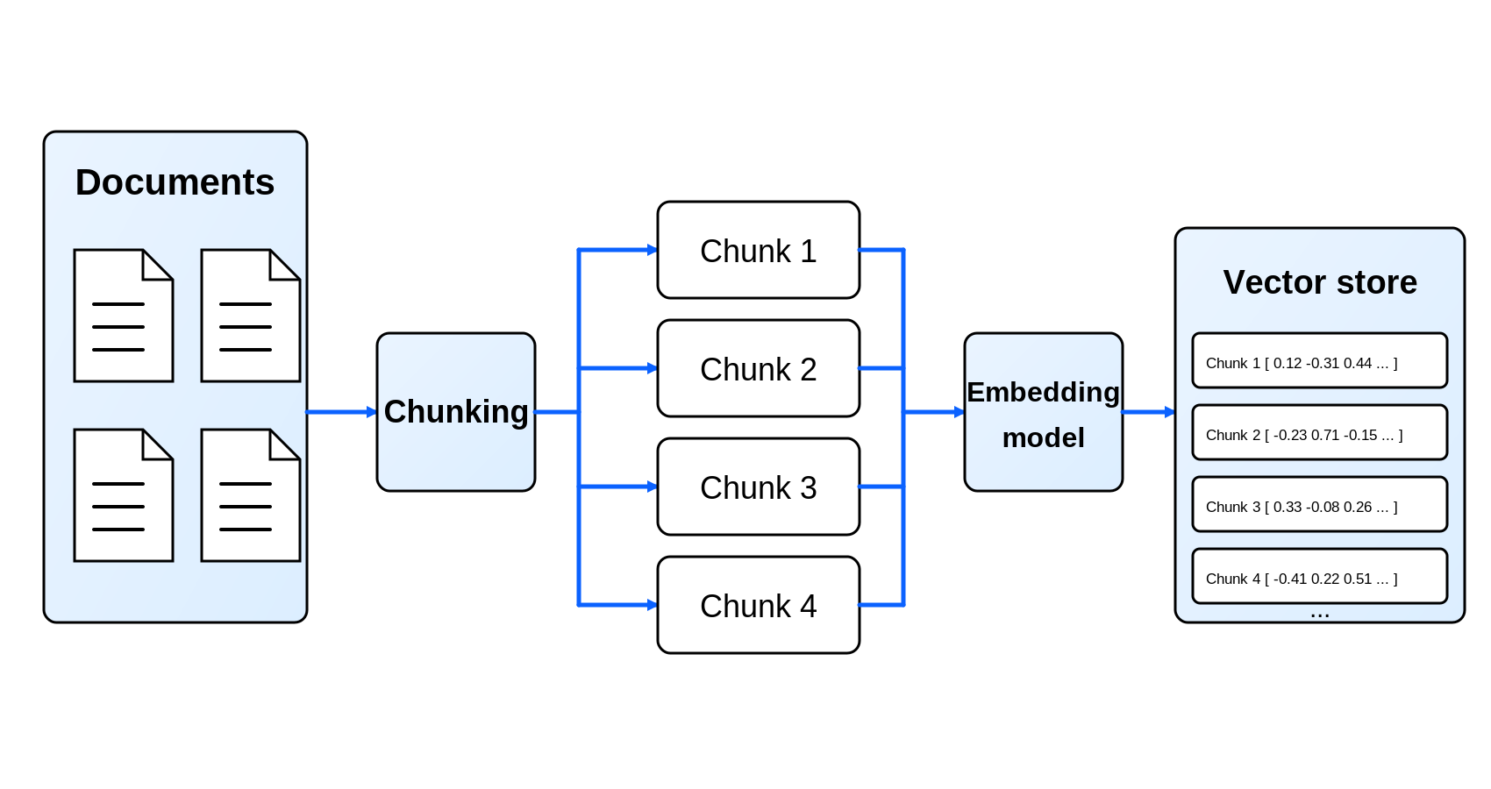
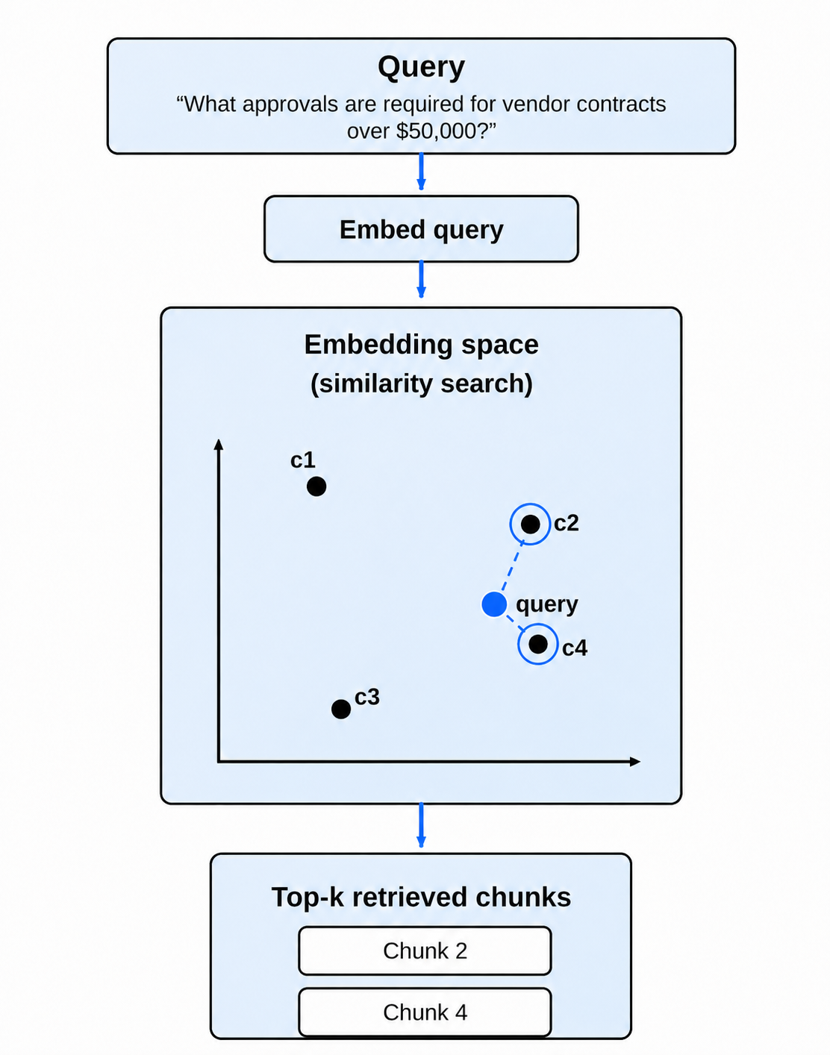
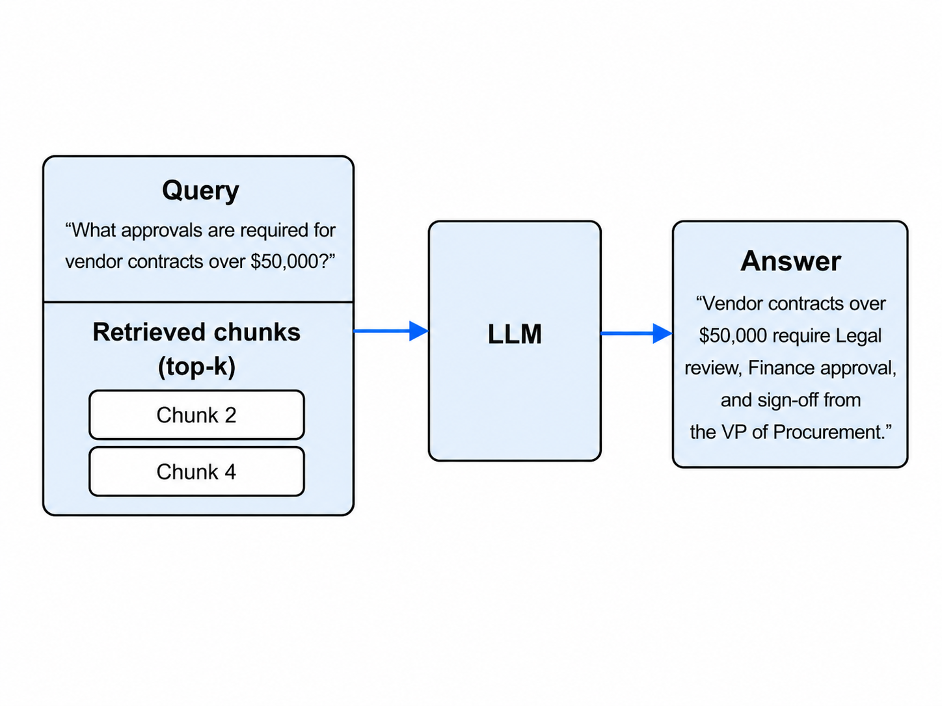
RAG Architecture

Slide 9
What Fine-Tuning Needs
Fine-tuning changes the model (SFT: prompt → ideal-answer pairs). What you need:
Examples
High-quality prompt / ideal-answer pairs
Target
Stable style, format, tone, or narrow domain behavior
Evaluation
A way to tell whether the tuned model got better
Risk
Bad examples teach bad habits very efficiently

Slide 10
The Three Levers Compared
Question
Prompting
RAG
Fine-tuning
Changes weights?
No
No
Yes
Adds new facts?
A little
Yes
Sometimes
Setup cost
Hours
Days to weeks
Weeks+
Best for
Behavior
Knowledge
Stable skill
Debug by
Inspect prompt
Inspect retrieval
Inspect examples
First move?
Usually
When facts matter
After evals

Slide 11
A Simple Debugging Rule
Bad format? Improve the prompt.
Missing or stale fact? Add retrieval.
Inconsistent repeated behavior? Consider fine-tuning.
Do not train your way out of a product problem.

Slide 12
15-min Break
z z z

Slide 13
Part 2: Product Sprint

Slide 14
What You Will Turn In
Teams: groups of 3 students
Deliverable: public app URL + short project write-up
Live date: 11:59pm PT, May 27
Final presentations: Week 10

Slide 15
What We Are Looking For
Build a small web app where AI meaningfully improves a real user's painful task.
Dimension
Strong project signal
User
A specific person with a real task
Workflow
Clear input, AI step, and useful output
AI value
Faster, better, cheaper, or more personalized
Product feel
Someone can use it without you narrating
Limits
Honest about what the app should not do

Slide 16
Good Starter Products
Advisor: interview prep coach for a specific role
Analyst: product-review summarizer with next-step recommendations
Workflow: customer-support triage for a small business
Knowledge tool: policy Q&A for an internal handbook

Slide 17
Not Every App Needs an LLM
Approach
Best when...
Example
LLM app
Language, reasoning, summarizing, conversation
Policy Q&A coach
CNN / MobileNetV2
Images are the input and classes are known
Plant disease classifier
Classic ML
Structured rows predict a number or class
Churn or demand prediction
When alternatives beat an LLM:
MobileNetV2: when the app mostly recognizes visual categories
Classic ML: when the app predicts from tabular features
LLM: when language, judgment, or flexible generation is central
You can combine them — e.g., ML prediction + LLM explanation

Slide 18
App Development Kit

Slide 19
Gemini 2.5 Flash: What It Can Do
Model code: gemini-2.5-flash
Inputs: text, images, video, audio; output: text
Useful for: low-latency, high-volume apps that still need reasoning
Supported: thinking, structured outputs, function calling, code execution
Also supported: file search, URL context, Search grounding, Maps grounding
Not supported in this model: image generation, audio generation, Live API

Slide 20
Gemini 2.5 Flash: Pricing + Limits
Spec
Value
Model code
gemini-2.5-flash
Inputs / output
Input: text, image, video, audio | Output: text
Context window
1,048,576 input tokens
Max output
65,536 tokens
Input price (text/image/video)
$0.30 per 1M tokens
Input price (audio)
$1.00 per 1M tokens
Output price
$2.50 per 1M tokens
Context caching
$0.03 per 1M tokens + $1.00 / 1M / hour storage
Free tier (AI Studio)
Yes — limited daily quotas for development
Rate limits
Project-level RPM / TPM / RPD (see AI Studio)
Fine-tuning
Not on this API — use Vertex AI for tuning
Batch API: 50% discount on input/output for async (24-hour) jobs. Pricing per ai.google.dev.

Slide 21
OpenAI GPT-4.1 Mini: Fine-Tuning Pick
Spec
Value
Model code
gpt-4.1-mini
Why this one for fine-tuning
Cheapest GPT-4.1 family member that supports SFT
Context window
1,000,000 input tokens; 32,768 output
Base input / output price
$0.40 / $1.60 per 1M tokens
Cached input price
$0.10 per 1M tokens (75% off)
Fine-tune training cost
~$5.00 per 1M training tokens (paid per epoch)
Fine-tuned inference price
~$0.80 in / $3.20 out per 1M tokens (~2x base)
Batch API discount
50% off input/output for async (24-hour) jobs
Rate limits
Tier-based; Tier 1 typically 500 RPM / 200K TPM
Image generation: gpt-image-1 (separate endpoint, per-image pricing)
1024×1024 image: ~$0.011 (low) / $0.04 (medium) / $0.167 (high). Mini variant from $0.005. Billed per image, not per token.

Slide 22
How the Tools Fit Together
Cowork / Codex
LLM API
edits code
explains errors
Gemini key
model response
Human
Project folder
Users
team chooses goal
and tests output
AppPlan, server,
HTML, prompts
open URL
try workflow
Railway
hosts public
web app
feedback loop: test, judge, revise

Slide 23
Sub-Part: Live Demo

